Slide 1

Object Oriented Design and Programming
Week 9
Version 2 – 18th December 2015

Slide 2
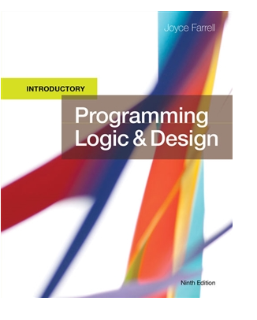
SLIDE TITLE
Farrell, J. (2017) Programming Logic and Design, Comprehensive (9th ed.) Cengage Learning

Slide 3
Objectives
In this part, you will learn about:
Constructors
Destructors
Setter and Getter methods

Slide 4
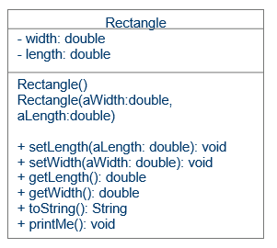
Continued from last week: Complete class diagram
Class name
List of variables
Constructor
Setters
Getters
Other methods

Slide 5
Understanding Constructors
Creating objects of class
Do you remember that line:
Scanner Sc= new Scanner(System.in);
Sc is name of object of Scanner class.
new is keyword that we use to create objects.
Writing Scanner(System.in) means that we are using Constructor of scanner class to create objects.
Similarly, you can create objects of your designed classes with the help of constructor.

Slide 6
Understanding Constructors
Constructor
A method that has the same name as the class
Establishes an object
Constructors fall into two categories:
Default constructor
Requires no arguments
Non-default or parameterized constructor
Requires arguments

Slide 7
Understanding Constructors (continued)
A class can have three types of constructors:
Default constructor –
automatically-created default constructor exists in a class in which the programmer has not explicitly written any constructors
Programmer-written default constructor can reside in any class and replaces the automatically-created one
Non-default or parameterized constructor
Written by programmer with one of more parameters

Slide 8
Default Constructors
Default constructor for the Employee class
Establishes one Employee object with the identifier provided
Declare constructors to be public so that other classes can instantiate objects that belong to the class
Write any statement you want in a constructor
Place the constructor anywhere inside the class
Often, programmers list the constructor first

Slide 9
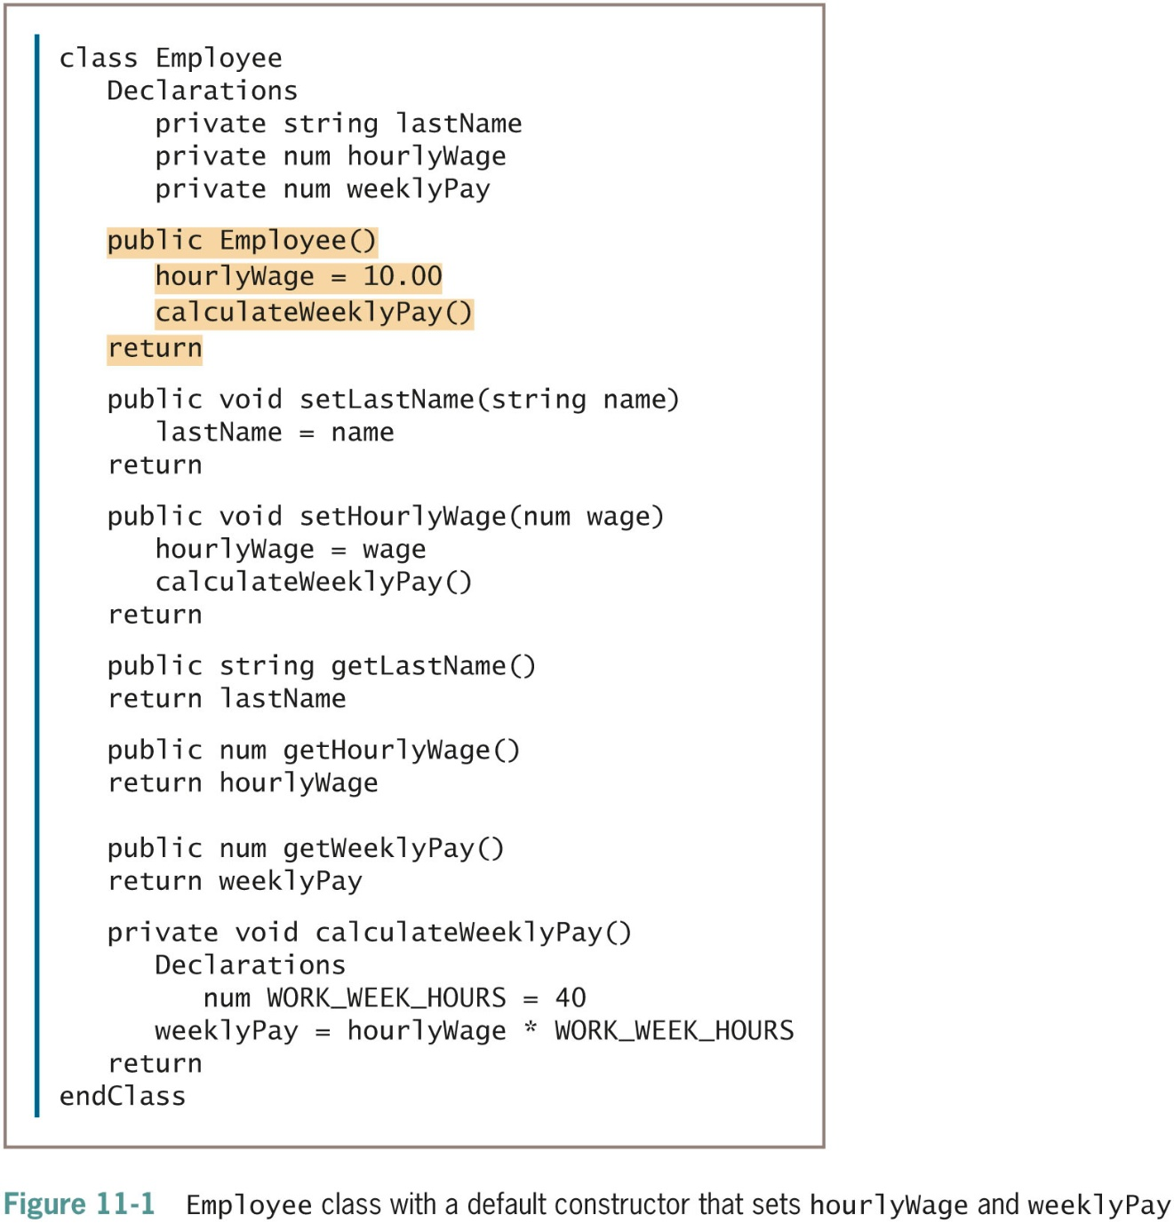
Default Constructors (continued -1)

Slide 10
Non-default Constructors
Choose to create Employee objects with values that differ for each employee
Initialize each Employee with a unique hourlyWage
Write constructors that receive arguments
Employee partTimeWorker(8.81)
Employee partTimeWorker(valueEnteredByUser)
When the constructor executes
Numeric value within the constructor call is passed to Employee()

Slide 11
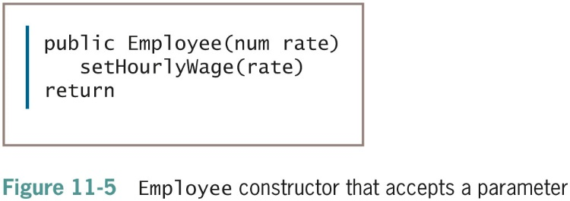
Nondefault Constructors (continued)
Once you write a constructor for a class, you no longer receive the automatically written default constructor
If a class’s only constructor requires an argument, you must provide an argument for every object of that class you create

Slide 12
Understanding Destructors
Destructor
A method that contains the actions you require when an instance of a class is destroyed.
Instance destroyed
When the object goes out of scope.
If you do not explicitly create a destructor for a class, one is provided automatically
Declare a destructor
Identifier consists of a tilde (˜) followed by the class name

Slide 13
Understanding Destructors (continued -1)
Cannot provide any parameters to a destructor
Empty parameter list
Only one destructor per class
A destructor has no return type
Programs never explicitly call a destructor
Invoked automatically
The last object created is the first object destroyed.

Slide 14
Setters
A method which is used for updating or setting the value of a variable is called setter method in Java.
This method is also known as mutator method.
By using the setter method, you can modify the value of a variable.
Naming convention for setter method:
setXyz() where Xyz is the name of the variable.

Slide 15
Setters
For setting the value, you need to pass the value that you want to set.
Method signature is as follows:
AccessSpecifier returntype setXyz(datatype variable)
AccessSpecifier will be depending upon the need of program.
Return type is mostly void because it does not return any value except in some cases where you want to return Boolean value to make sure that value has been set.
It receive variable that need to be set as parameters and need to mention data type of it.

Slide 16
Setters
Consider a Rectangle class to create various rectangles of different dimensions.
It can have length and width as private variables.
To set their values, you should have setter methods in class.

Slide 17
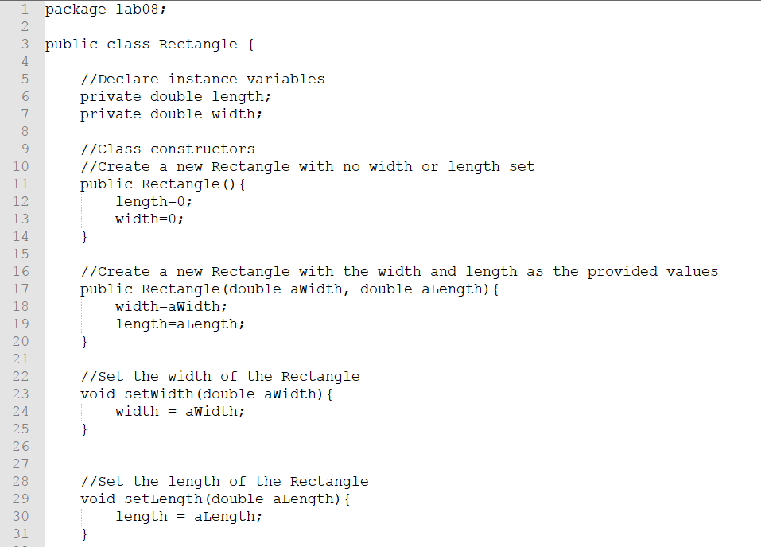
Setters

Slide 18
Getters
A method which is used to retrieve/get the value of a variable or return the value of the private member variable is called getter method in Java.
This method is also known as an accessor method.
For every private variable, you should create a getter method.
Depending on the access level you want to give to the variable, you can set the access modifier of its getter method.
If you declare instance variables as private, you add public getter methods for each one.
Naming convention for getter method:
getXyz() where Xyz is the name of the variable.

Slide 19
Getters
To get the value, getter should return the value. Method signature is as follows:
AccessSpecifier returntype getXyz()
AccessSpecifier will be depending upon the need of program.
Return type is according to the value you are returning.
Next slide, same example of rectangle with getter methods.

Slide 20
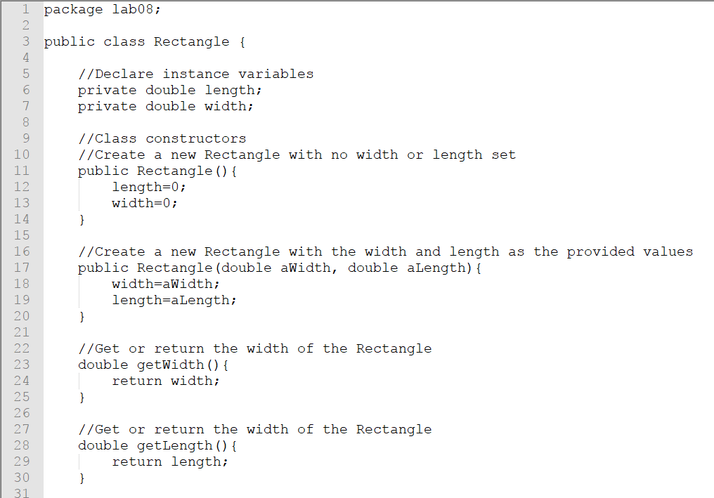
Getters

Slide 21
Other methods
Methods that perform some functions on the data.
You can write as many as you want.
Have a look on file Rectangle.java to get an idea of other methods.
One of the most common method is toString()
Implementing toString method in java is done by overriding the Object’s toString method.
Keep this in mind, we will discuss this next week after inheritance.

Slide 22
Testing the classes
You must be wondering what is the purpose of class.
Whatever we have created is just a dummy class.
How can we use this class?
How to create object of this class?
Ideal way is to create a new class called test class and write main method in it.
Let us do it for Rectangle Class.
We will create a new test class.

Slide 23
Creating objects
Recall from slide no 20
Follow the same to create an object
Rectangle R1= new Rectangle();
Rectangle R2= new Rectangle(6.5,9.5);
First line will create an object and give it default values that you have entered in constructor.
Second line will create an object and give it the values as you have passed.
We can use print statements to print the values of this Rectangle using getter method.

Slide 24
Using methods of class
You can use objects to use methods of a class.
The (.) operator is also known as member operator it is used to access the member of a package or a class.
Now to access setLength() method of class, you will write R1.setLength(5.5)
It will set the length of object named R1 to 5.5

Slide 25
“this” operator
Within an instance method or a constructor, this is a reference to the current object — the object whose method or constructor is being called.
You can refer to any member of the current object from within an instance method or a constructor by using this.
Watch this following video to understand:
https://www.youtube.com/watch?v=kZdwXMzMwYY

Slide 26
Tutorial Activity
Rectangle class is provided on moodle.
You need to test it by creating a different class.
Instructions are given in tutorial document.

Slide 27

kent.edu.au Kent Institute Australia Pty. Ltd. ABN 49 003 577 302 ● CRICOS Code: 00161E ● RTO Code: 90458 ● TEQSA Provider Number: PRV12051

